Slide 1

Batch 26 · PG Certification Programme in AI/ML· RAG Group 5
+
§
$
◎
BIO
LAW
FIN
GEN
Building and Evaluating RAG Systems with RAGBench
A Multi-Domain RAGBench Study · Biomedical · Legal · Financial · General Knowledge
Arhan · Dhananjay · Pritvish · Venkat · Capstone Project 2026

Slide 2

















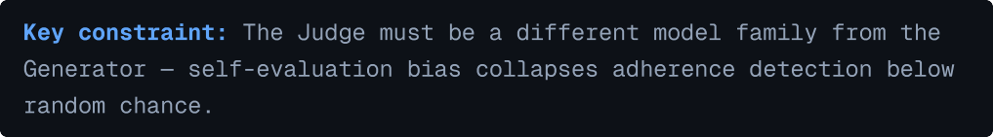
→
→
←
←

Slide 3




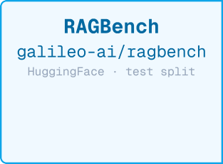
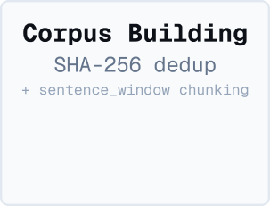

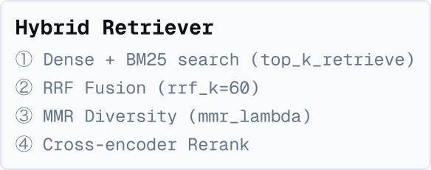
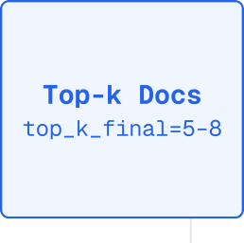

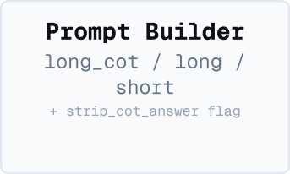
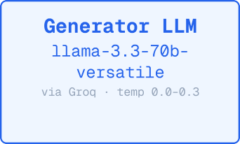
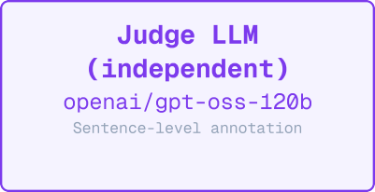
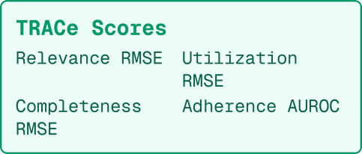
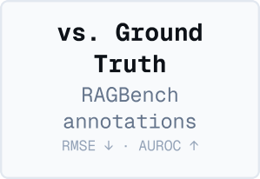
→
→
→
→
→
→
→
→

Slide 4













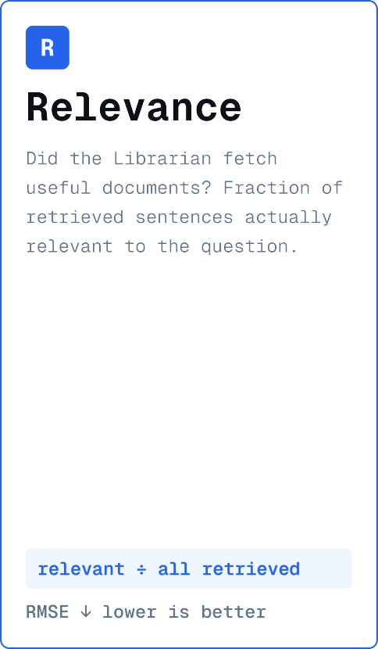
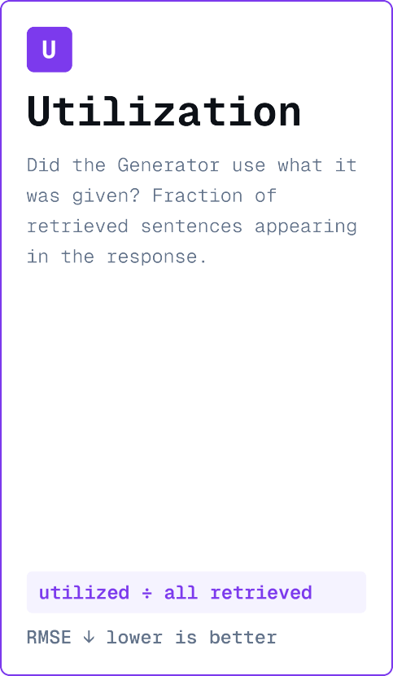
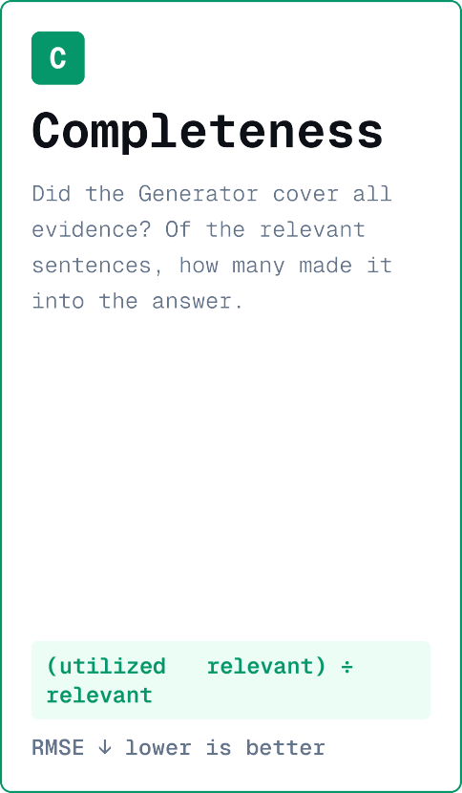
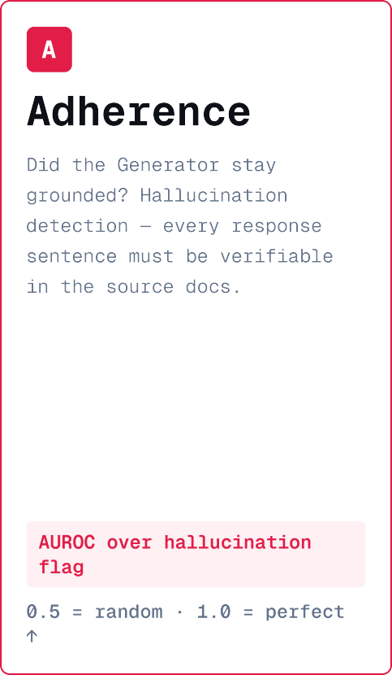
∩

Slide 5








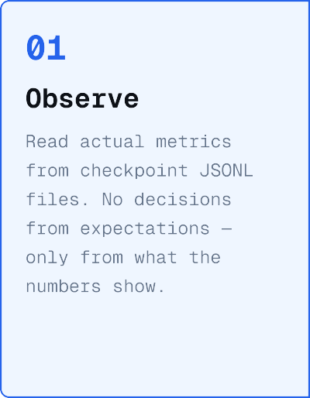
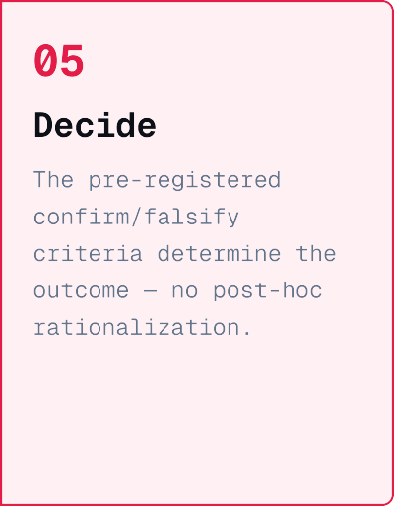







Slide 6






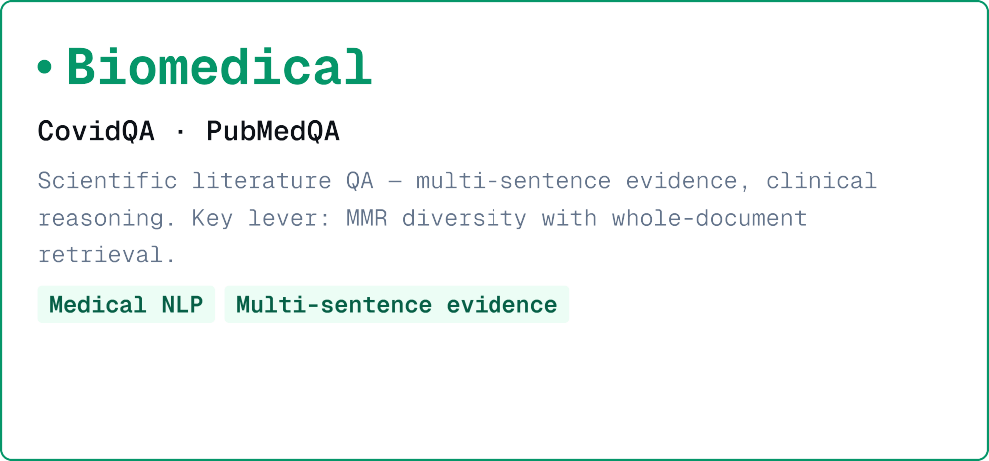
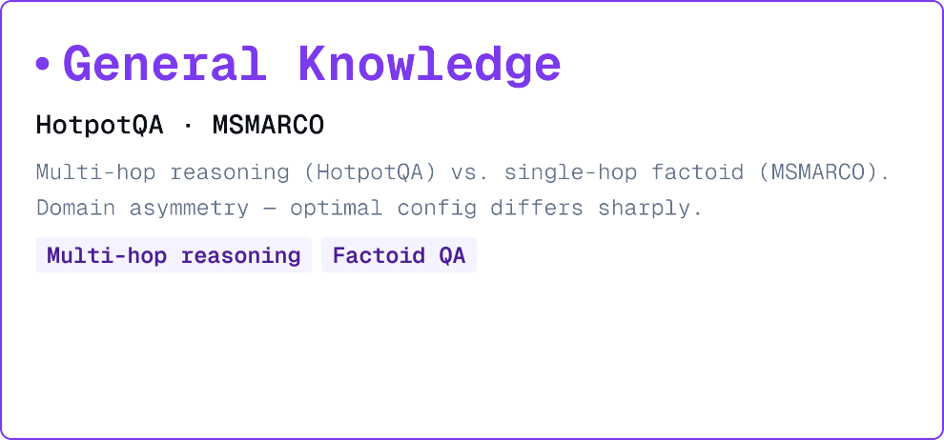
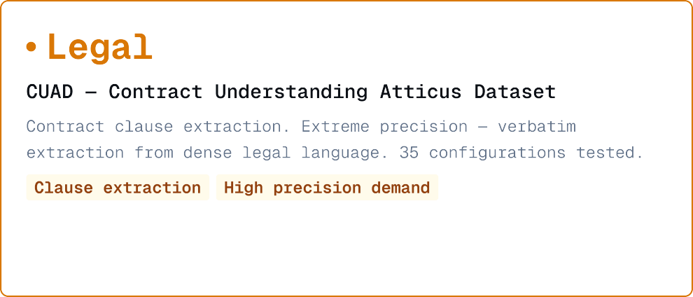
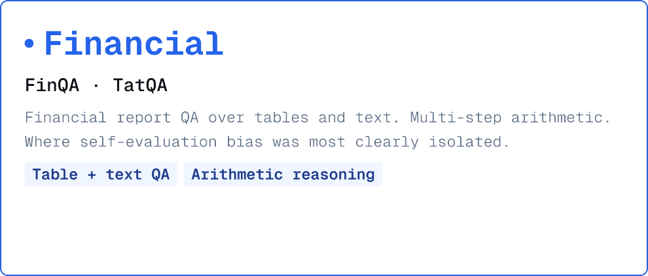

Slide 7






















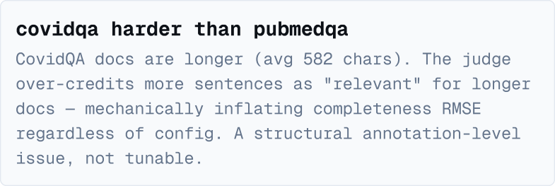






→
→
→
→

Slide 8

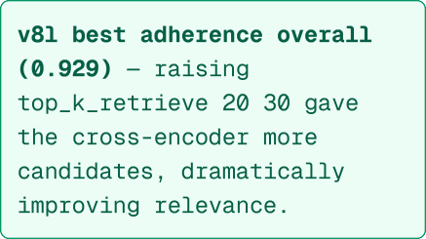
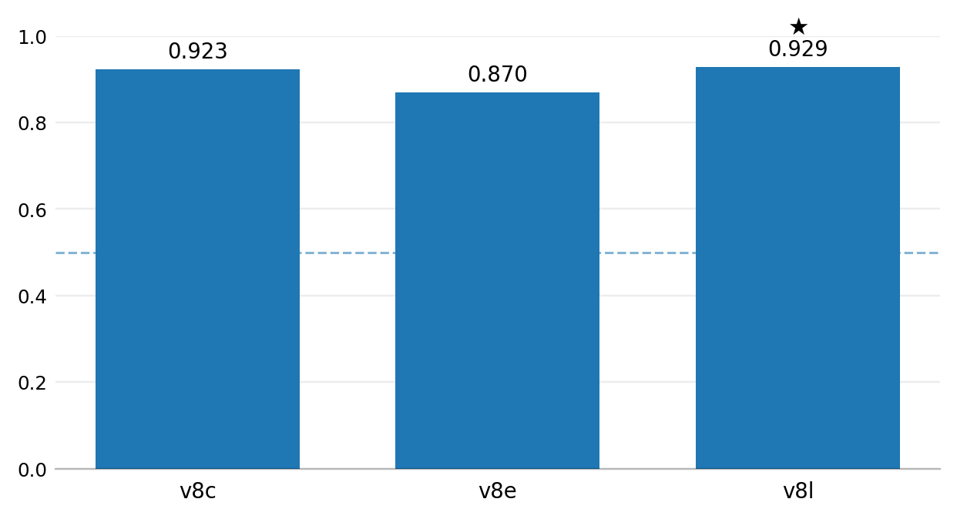
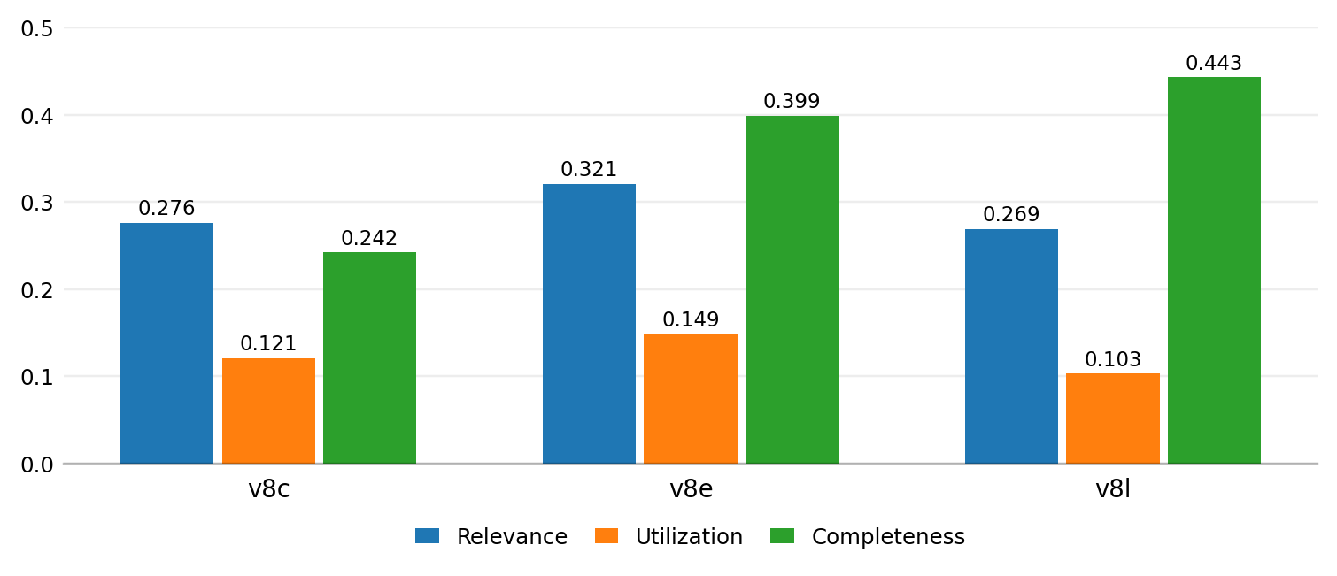
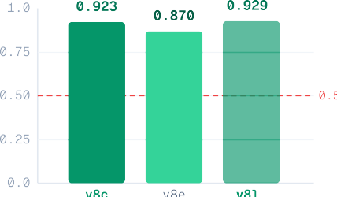
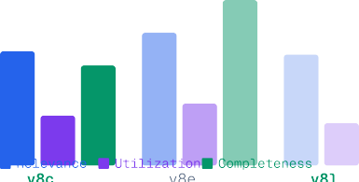
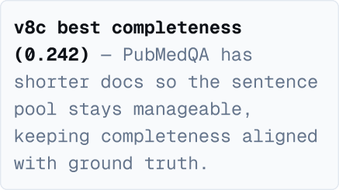
★
→
★

Slide 9

























The Core Challenge
→
Legal clause extraction exposes a fundamental tradeoff: maximizing Adherence (hallucination resistance) forces verbose outputs that destroy Utilization precision. Standard prompt engineering cannot escape this triangle — you gain one at the cost of another.
The Breakthrough: Structural JSON Decoupling
The rich_dual_track prompt forces the model to reason inside a hidden JSON object, then output only a single extracted sentence. Result: near-perfect Utilization (0.0599 RMSE) and strong Adherence (0.81 AUROC) simultaneously — escaping the triangle.
→
→
Journey: 35 Iterations
Started with 8B generator → upgraded to 70B → tested JSON CoT → parent-child retrieval → chunk sizes 256 to 1024 → finally custom dual-track prompting at 800-char chunks with hybrid RRF retrieval.

Slide 10
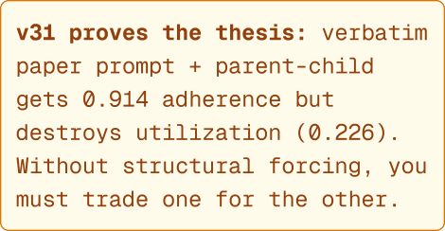
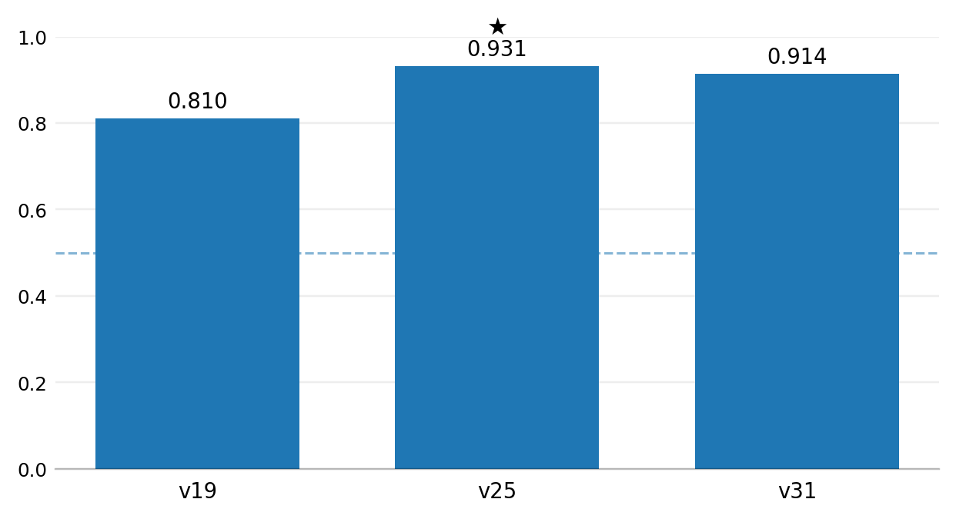
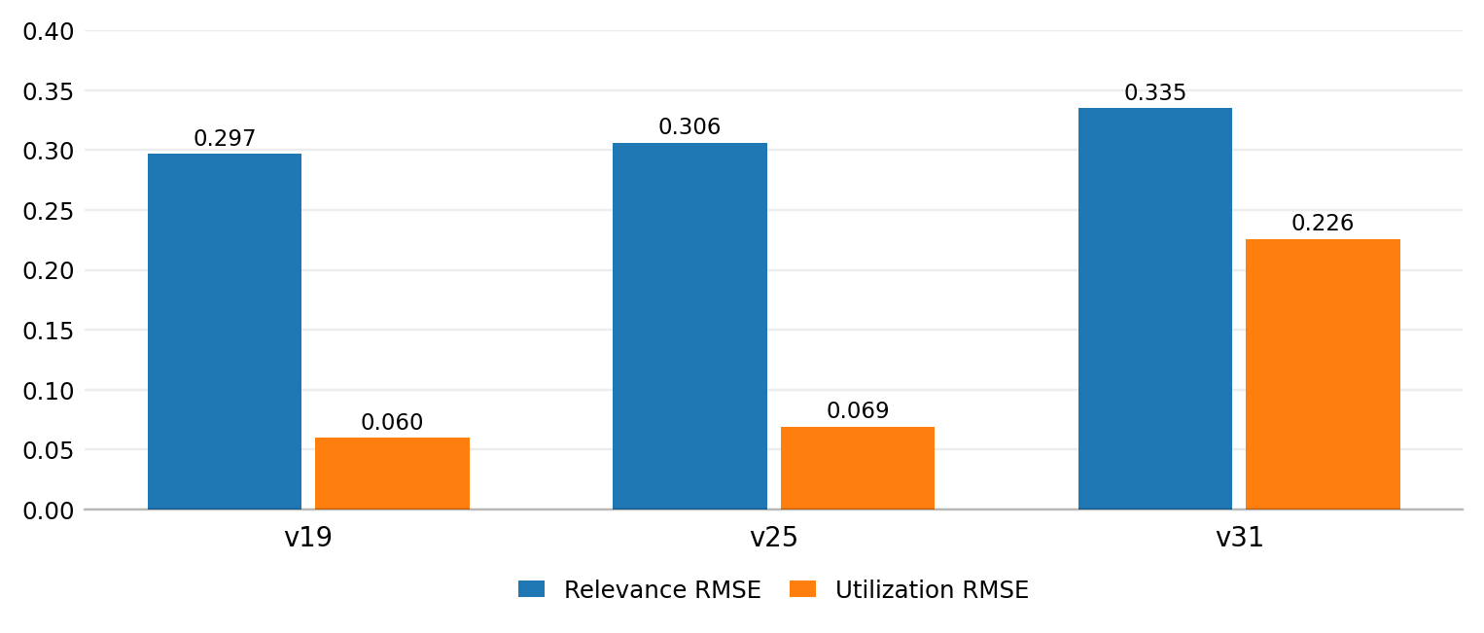
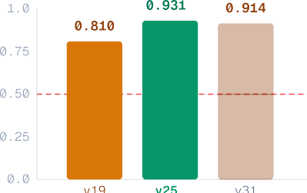
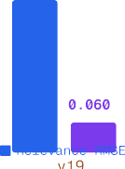
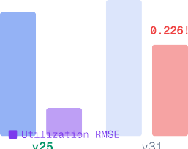
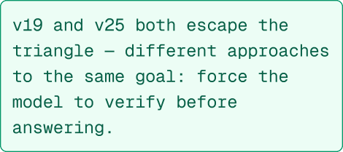
★
★
★
★

Slide 11






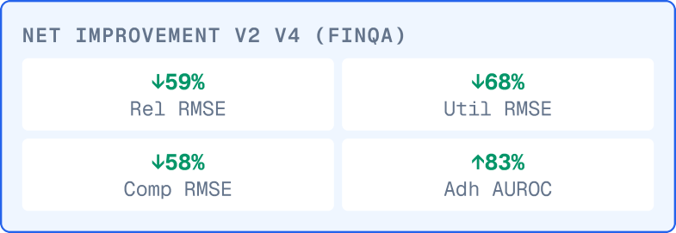







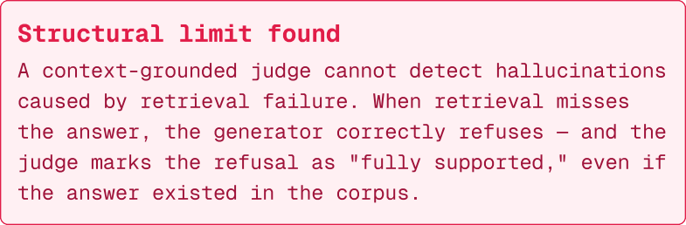





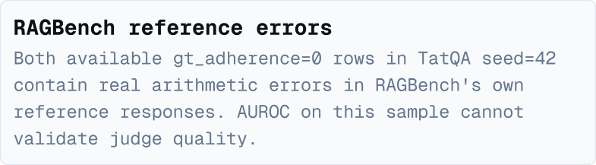














→
→
→

Slide 12


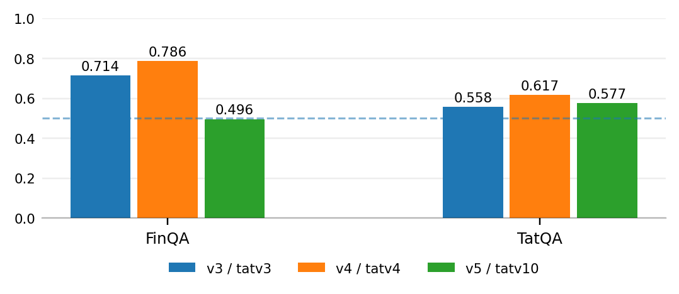
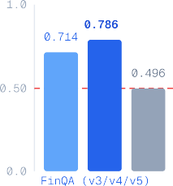
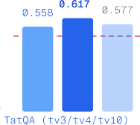

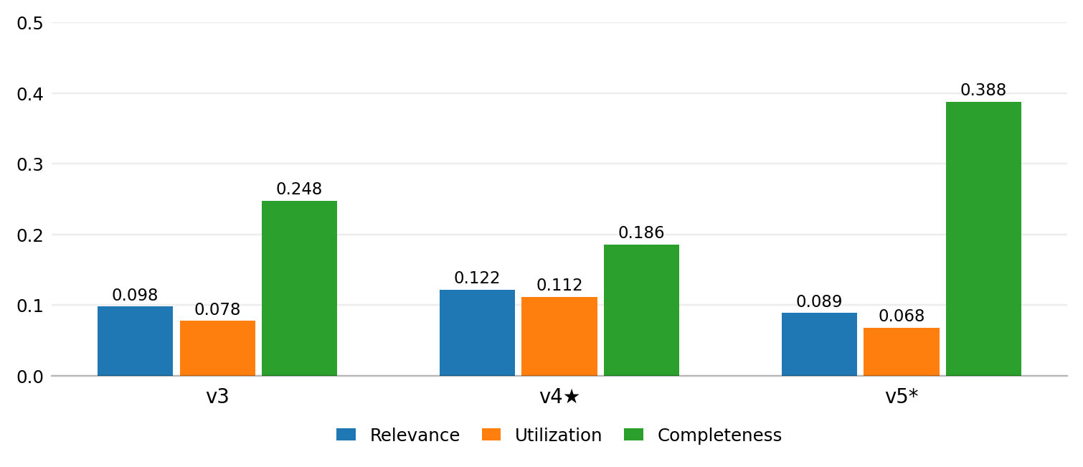
★
★
★
★
★
★

Slide 13



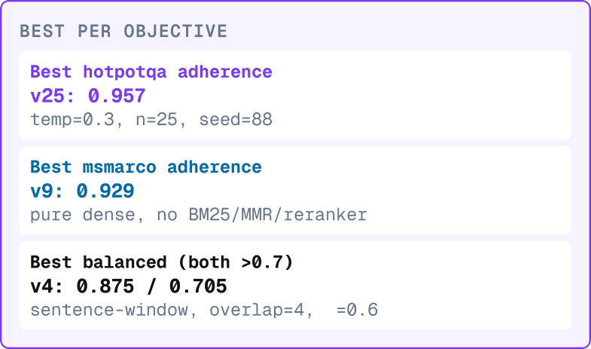













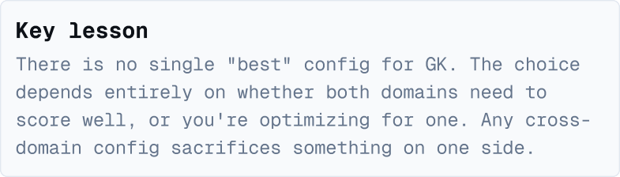











λ
λ

Slide 14


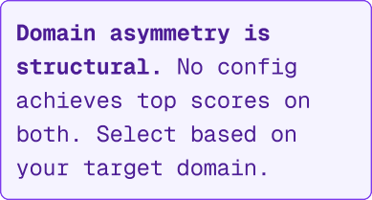
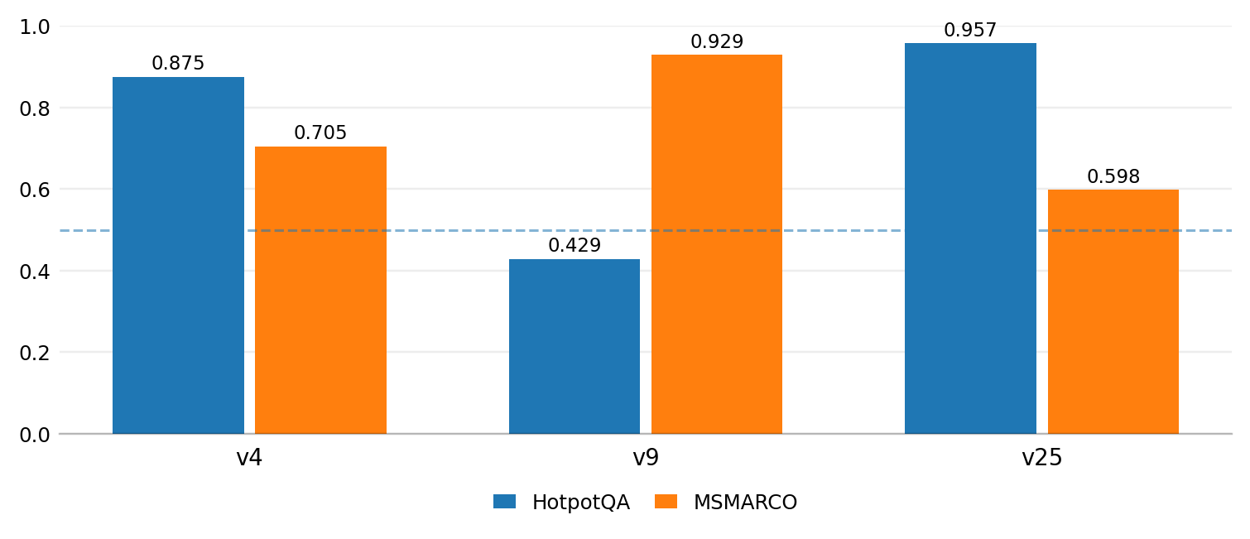
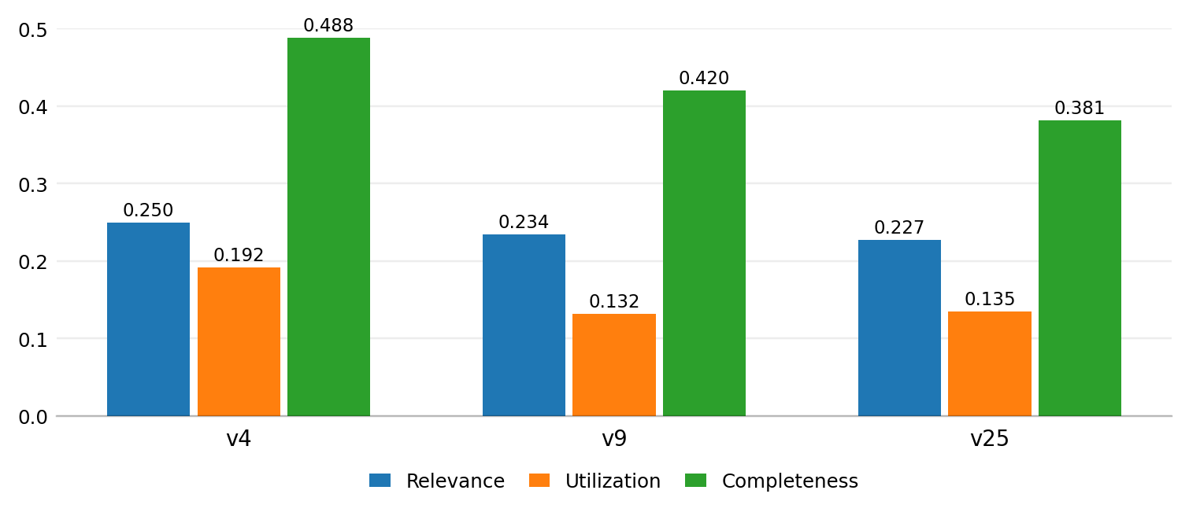
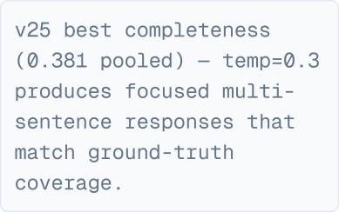
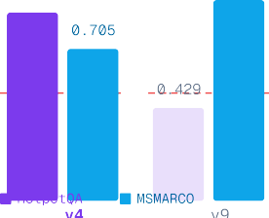
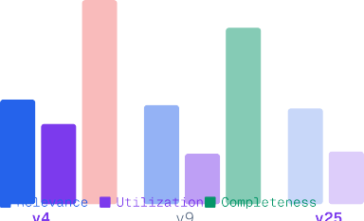
λ
★
★

Slide 15









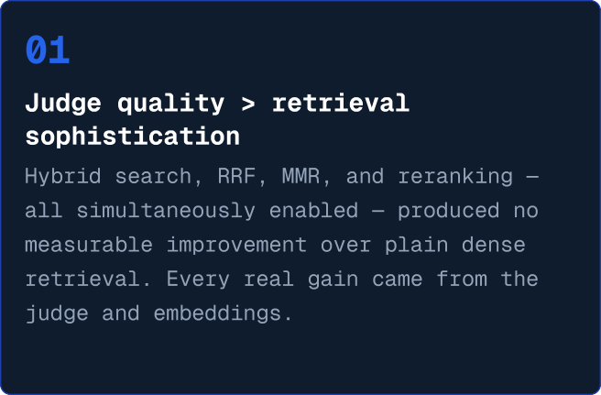





→

Slide 16
RGB EVALUATION
RGB: Four Robustness Abilities
N
R
I
C
Noise Robustness
Negative Rejection
Information Integration
Counterfactual Robustness
Does accuracy hold as irrelevant-but-topically-related passages are mixed into the retrieved set? Tested at noise ratios from 0.0 up to 0.8.
Does the model recognize when none of the 5 retrieved passages answer the question, and refuse instead of guessing an answer?
Can the model synthesize one answer that requires combining evidence scattered across multiple retrieved passages, under noise?
Does the model detect when a retrieved passage contradicts known facts, flag the error, and still answer correctly despite it?
noise ratio 0.0 → 0.8
Rej = refusals ÷ all queries
multi-passage synthesis
ED · CR = detect & correct
Accuracy ↑ higher is better
Rejection rate ↑ higher is better
Accuracy ↑ higher is better
Error Detect. / Correction ↑
Benchmark:
RGB — Reliability Gap Benchmark, English subset (en_*.json), served via Groq API
Models tested:
Llama-3.1-8B & 3.3-70B, Qwen3-27B, GPT-OSS-20B

Slide 17
RGB
Noise · Negative Rejection · Information Integration · Counterfactual
RGB: Results Summary
Ability
Dataset (n)
Best Model
Score
Note
Noise Robustness
en_refine.json (n=300*)
llama-3.1-8b-instant
98.7 → 95.0%
Near-ceiling across all ratios; only dips at noise=0.8. Other two models verified only at n=100.
Negative Rejection
en_refine.json, noise=1.0 (n=300)
openai/gpt-oss-20b
76.33% Rej
Best-calibrated, lowest hallucination rate. All 3 models comfortably beat the paper's 31% baseline.
Information Integration
en_int.json (n=50, pilot)
llama-3.3-70b-versatile
90.0 → 88.0%
Holds up best under noise; 8B model degrades hardest (84.0% → 62.0%).
Counterfactual Robustness
en_fact.json (n=100)
qwen/qwen3.6-27b
95.0 ED · 86.3 CR
Clear lead in error detection over both Llama models (37% / 52% ED).
Scoring Bug Found & Fixed
Evaluation Stage Caveat
A Unicode narrow-no-break-space / smart-punctuation mismatch was silently breaking the exact-match scorer for openai/gpt-oss-20b across Noise, Information Integration & Counterfactual. Raw scores looked catastrophic (6–12%); corrected, they're competitive (60–78%) — caught only by reading raw predictions by hand.
Sample sizes differ by ability: Negative Rejection (n=300) and Counterfactual (n=100) are full-dataset and final. Noise Robustness is full n=300 only for the 8B model. Information Integration is still pilot-scale (n=50).
* gemma2-9b-it was deprecated by Groq (Oct 2025) and replaced with openai/gpt-oss-20b across all four RGB abilities.

Slide 18






Slide 19
SOURCES
References
[1] Adeyemi, O. et al. RAGBench: Explaining Retrieval Augmented Generation and Grounded Question Answering. arXiv:2407.11005 (2024).
[6] Galileo AI. RAGBench Dataset: galileo-ai/ragbench. HuggingFace Hub.
[7] Robertson, S. & Zaragoza, H. The Probabilistic Relevance Framework: BM25 and Beyond. Foundations and Trends in Information Retrieval (2009).
[2] Groq Inc. Groq API Documentation. console.groq.com/docs
[3] LanceDB Team. LanceDB: Serverless Vector Database. lancedb.github.io/lancedb
[8] Carbonell, J. & Goldstein, J. The Use of MMR, Diversity-Based Reranking for Reordering Documents and Producing Summaries. SIGIR (1998).
[4] Johnson, J. et al. FAISS: A Library for Efficient Similarity Search. Facebook AI Research.
[9] Chen, J. et al. Benchmarking Large Language Models in Retrieval-Augmented Generation. arXiv:2309.01431 (2023).
[5] Reimers, N. & Gurevych, I. Sentence-Transformers: Multilingual Sentence, Paragraph, and Image Embeddings. HuggingFace.
[10] RAGBench Top-3 Demo (Gradio App). pritvish.github.io/ragbench-top3-demo/rag-demo/

